Slide 1
Capstone Project-4
NETFLIX MOVIES AND TV SHOWS CLUSTERING
Kundan Lal (Coh Hardeol), Abhijeet Kulkarni
Pankaj Ganjare , Mohd sharik

Slide 2

Content:
Introduction
Problem Statement
Data Description(7787 x 12)
Null Value
Exploratory Data Analysis
Outlier detection
NLP
K- Modes
Hierarchical Clustering
Spectral Clustering
Implementing D.B Scan
K- Means
Cluster Analysis

Slide 3

Data Description
The data was collected from Flixable which is third party Netflix
search engine. The dataset consists of movies and TV shows data till
2019. The dataset has 7787 rows & 12 Columns of data.
The dataset consists of eleven textual columns and one numeric
column.
Attribute Information :
show_id : Unique ID for every Movie / Tv Show
type : Identiﬁer - A Movie or TV Show
title : Title of the Movie / Tv Show
director : Director of the Movie

Slide 4
Data Description
5. cast : Actors involved in the movie / show
6. country : Country where the movie / show was produced
7. date_added : Date it was added on Netﬂix
8. release_year : Actual Release year of the movie / show
9. rating : TV Rating of the movie / show
10. duration : Total Duration - in minutes or number of seasons
11. listed_in : Genre
12. description: The Summary description

Slide 5

Introduction
Netflix is a company that manages a large collection of TV shows and movies, streaming it anytime via online. This business is profitable because users make a monthly payment to access the platform. However, customers
Netflix:
can cancel their subscriptions at any time.
Unsupervised Machine Learning (Clustering)
Methodology:
Netflix Movies and TV Shows
7787 rows and 12 columns
Data from last decade
Database:

Slide 6


Problem Statement ..
This dataset consists of tv shows and movies available on Netflix as on 2019. The dataset is collected from Flixable which is a third-party Netflix search engine.
In 2018, they released an interesting report which shows that the number of TV shows on Netflix has nearly tripled since 2010. The streaming service’s number of movies has decreased by more than 2,000 titles since 2010, while its number of TV shows has nearly tripled. It will be interesting to explore what all other insights can be obtained from the same dataset.
In this project, you are required to do
Exploratory Data Analysis
Understanding what type content is available in different countries
Is Netflix has increasingly focusing on TV rather than movies in recent years.
Clustering similar content by matching text-based features

Slide 7
Null Value
Null Value Treatment:
● Director feature have more than 30.68% of null values. Filling null values by ‘None’.
● Country feature have 6.51% of null values. Filling null values by ‘Missing’.
● Cast feature have 9.22% of null values. Filling null values by ‘Not Available’.
● Rating feature have 0.09% of null values. Filling null values by mode of feature.
● Date_added feature have 0.13% of null values. Dropping rows corresponding to null values.

Slide 8
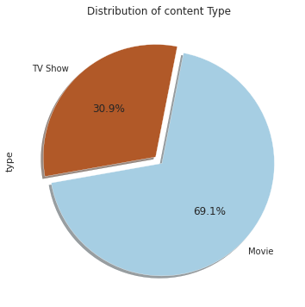
EDA From plot we can say that there is 30.9% content from TV shows and 69.1% from Movie.

Slide 9
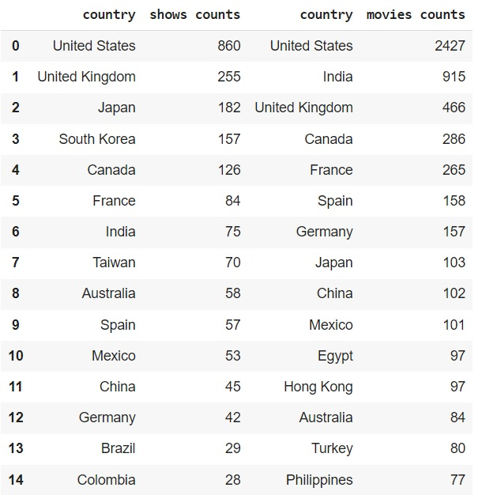
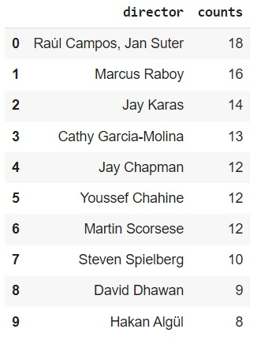
Top 15 countries based on content type Top 10 directors who have directed most movies

Slide 10
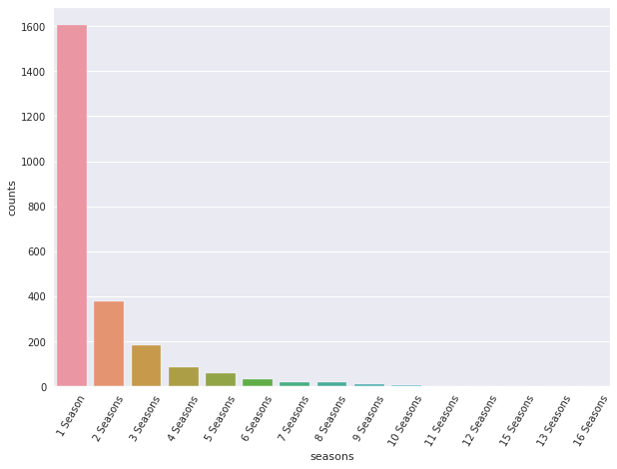
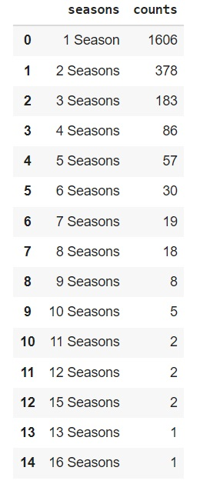
seasons distribution for TV shows There are only few TV shows which crossed 8 season most of seasons have released in one 1 season and some have 2-3 seasons.

Slide 11
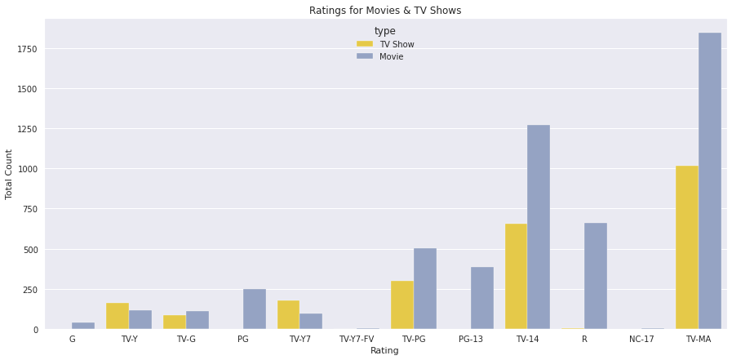
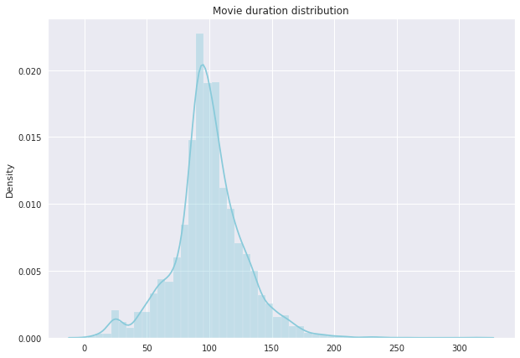
Movie duration distribution Distribution is positively skewed and there are very less movies which have crossed 175 mins. Distribution of various ratings Most contents are Matured rated on Netflix and there are very less G-rated contents

Slide 12
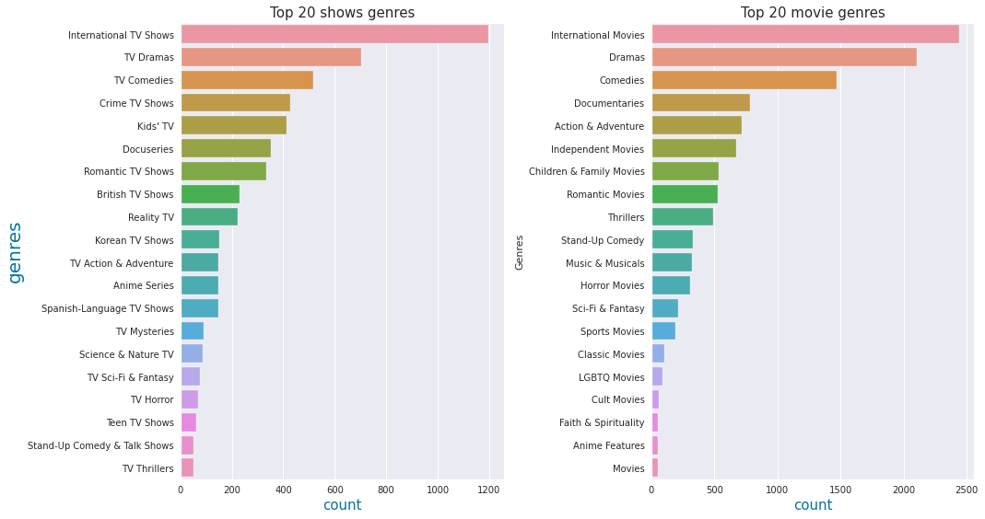
Top 20 movie genres in movies and TV shows In both type international genres is on top in the list followed by drama and comedies respectively.

Slide 13
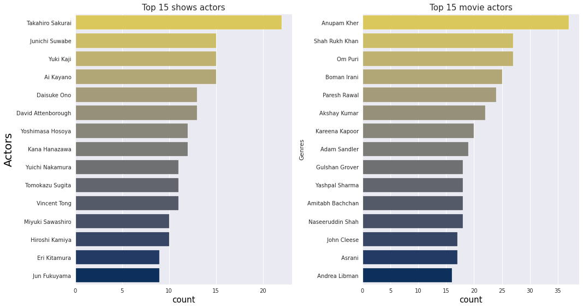
Top actors who worked in most content in movies and TV shows. actors who were part of most shows and movies which gave us that Takahiro sukurai has worked in most shows and Anupam kher has worked in most movies.

Slide 14
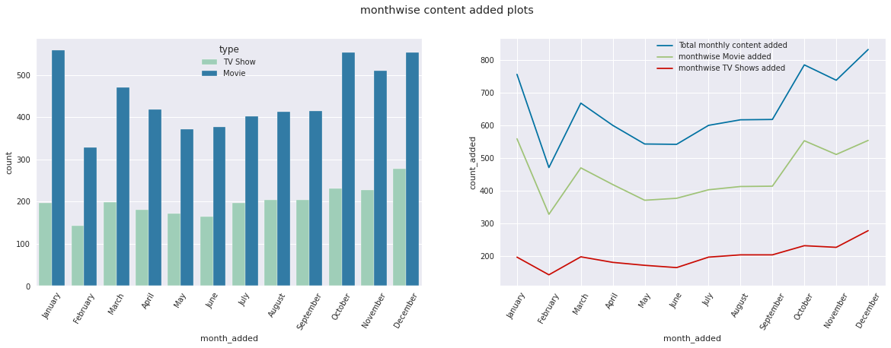
Month wise content distribution With the help of month wise analysis we have found that most content is added on the platform in the month of Nov, Dec, and Jan.

Slide 15
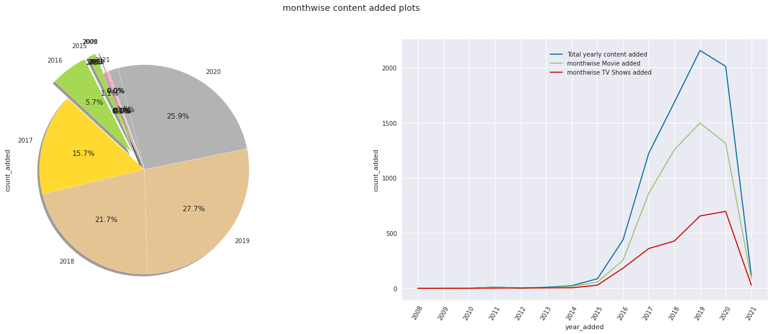
Year wise content distribution In this distribution we have found that in recent year content is added on the platform exponentially. also we have found that between 2019 to 2020 Netfilx has added more shows in comparison of movies

Slide 16
Outlier detection
After preforming EDA on the dataset we got rid of outliers using Isolation Forest since outliers can lead to bad clustering hence anomalies and outliers must be removed from the dataset before clustering.
The nature of columns and values of these columns are such that , most of the columns contain a lot unique values hence we cannot detect outliers however we checked for the outliers in country and duration column if it exists.
basis on this data we cannot find outlier rows in country column.

Slide 17
Outliers in duration
we have two content types (TV shows and movies ) and the values are different in both these types hence we will perform these tasks separately in two individual data frames. i.e shows_df & movie_df.
detecting outlier detection in shows_df as in this data frame duration columns contains categorical values i.e seasons
based on this result we can assume that there are less than 1 percent shows which are 7 seasons or longer hence we can consider these seasons as outliers
we will be using isolation forest technique to detect outlier in duration column of
movies_df

Slide 18
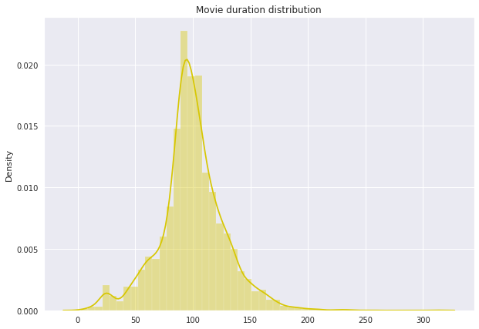
Movie duration distribution

Slide 19
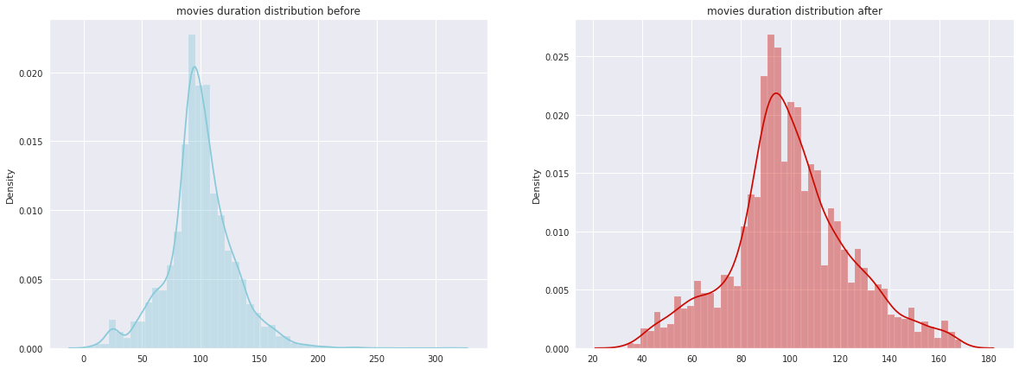
Movie duration distribution before & after Normalization

Slide 20
Applying NLP
we have developed an NLP algorithm that can give us similar content. however, based on the nature of the content like movie/ TV show we have developed two function so that we can get similar movies for a given and TV shows . To achieve this we have used TF-IDF vectorizer and cosine similarity. the details of both these are given above when we used them.
Since we have used the TF-IDF vectorizer, calculating the dot product will directly give us the cosine similarity score. Therefore, we will use sklearn's linear_kernel() instead of cosine_similarities() since it is faster.

Slide 21
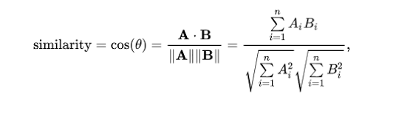
Cosine similarity -We will be using the cosine similarity to calculate a numeric quantity that denotes the similarity between two movies. We use the cosine similarity score since it is independent of magnitude and is relatively easy and fast to calculate. Mathematically, it is defined as follows:

Slide 22
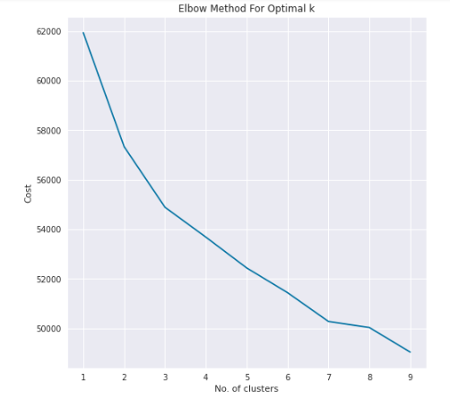
K-modes Clustering
Why K-modes ?
Since we had categorical data and K-modes clustering algorithm was established for categorical data. It works on the modes of categorical data. i.e most occurred observations and build clusters for most similar points.
3 clusters are best no. according to K-Modes:
An Elbow plot was plotted using K-modes algorithm to decide the best suitable no. of cluster for the given dataset. Using this plot we can say that the most suitable no. of clusters is 3 .

Slide 23
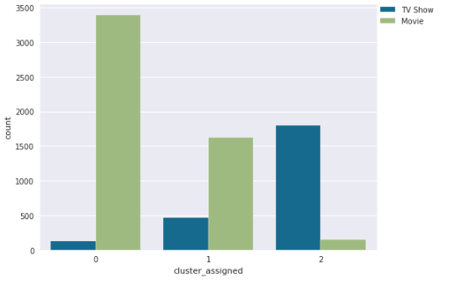
K-modes Clustering
How the no. of points(content) falls in each cluster ?
After algorithm implementation a count plot was plotted to visualize no. of points falls in each cluster.
Most movies are in cluster 0
2. More movies are there in cluster1 but as compared to cluster 0 , Tv shows are more.
3. Mostly TV shows are there in cluster two having only few movies .

Slide 24
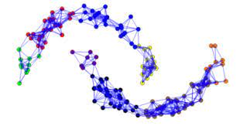
Spectral Clustering
In spectral clustering, the data points are treated as nodes of a graph.
Using Spectral clustering on transformed data we were able to built 2 clusters which is different results from K-Mode algorithms.
We can see that how the clusters are separate from each other.
Clusters made 2 .

Slide 25
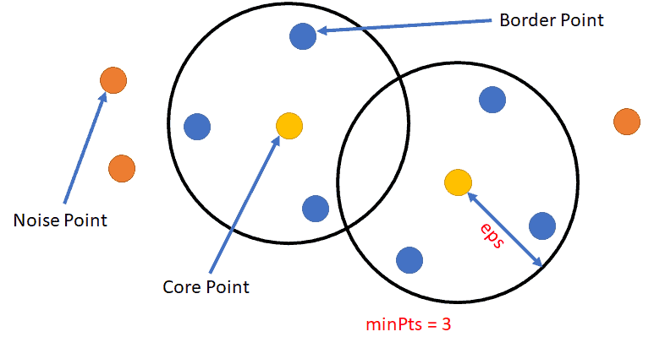
Implementing D. B Scan Algorithm
DB SCAN is an unsupervised learning algorithm for clustering. This algorithm is Density-based Spatial Clustering of Applications with Noise.
Its a density based clustering non-parametric algorithm: given a set of points in some space, it groups together points that are closely packed together (points with many nearby neighbors , marking as outliers points that lie alone in low-density regions .

Slide 26
D. B Scan Hyper-parameters.
Epsilon is the local radius for expanding clusters. Think of it as a step size - DBSCAN never takes a step larger than this, but by doing multiple steps DBSCAN clusters can become much larger than eps .
Min_Samples refers to the number of neighboring points required for a point to be considered as a dense region, or a valid cluster. Default is 5 .
The algorithm to be used , usually its set as “auto” .
Leaf_size value (default = 30) , It is Leaf size passed to BallTree or cKDTree. This can affect the speed of the construction and query, as well as the memory required to store the tree.
random state is a model hyper parameter used to control the randomness involved in machine learning models.
No of Clusters formed 3
Epsilon
Min Sample
Algorithm
Leaf Size
Random State

Slide 27
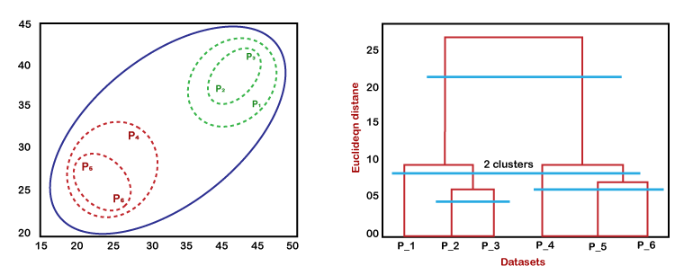
Implementing Hierarchical Clustering
Dendrograms are used to visually represent clustering operations, specifically agglomerative and divisive hierarchical clustering.
Agglomerative hierarchical clustering is where the elements start off in their own cluster and then are repeatedly combined by some criteria until all are in one cluster.
Divisive hierarchical clustering is where all elements start off in the same cluster, and then repeatedly broken by some criteria until all are in their own cluster.

Slide 28
Hierarchical (Agglomerative clustering) Hyper-parameters.
n_clusters
Affinity
Linkage
random_state
locate the largest vertical difference between nodes, and in the middle pass an horizontal line. The number of vertical lines intersecting it is the optimal number of clusters.
Euclidean , .___________. , distance between 2 data points on a plane.
Average-linkage and complete-linkage are the two most popular distance metrics in hierarchical clustering.
random state is a model hyperparameter used to control the randomness involved in machine learning models.
No. Of Clusters formed - 2

Slide 29
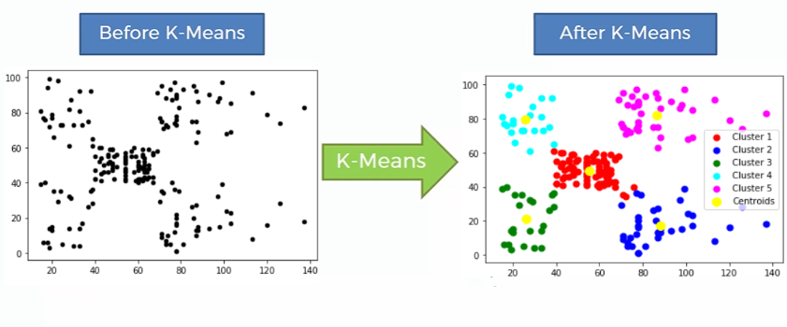
Implementing K-Means Clustering
K-means clustering uses “centroids”, K different randomly-initiated points in the data, and assigns every data point to the nearest centroid.
it aims to partition data into k clusters in a way that data points in the same cluster are similar and data points in the different clusters are farther apart.

Slide 30
K-Means Clustering Algorithm Hyper-parameters.
silhouette score
n_clusters
Silhouette score is used to evaluate the quality of clusters created using clustering algorithms like K-Means in terms of how well samples are clustered with other samples that are similar to each other.
*1 being the best . Range -1 to 1 .
The number of clusters formed with the same number of centroids .
No. of Clusters Formed - 2

Slide 31

Our Findings
Data set contains 7787 rows and 12 columns in that cast and director features contains large number of missing values so we can drop it.
We have two types of content TV shows and Movies (30.9% contains TV shows and 69.1% contains Movies).
Most films were released in the years 2018, 2019, and 2020 and united states have the maximum content on Netflix.
The months of October, November, December and January had the largest number of films and Tv-shows released.
USA, India, the United Kingdom, Canada, and Egypt are the top five producer countries.
For the clustering algorithm, we utilized type, director, nation, released year, genre, and year.
Results of different clustering Algorithms :-
• Using K –Modes ,in elbow plot we can clearly see that the elbow is formed at 3 , so the number of clusters formed as per K-Modes is 3 .
• Using DB Scan ,As shown by the color codes of the DB Scan graph, it can be seen that the algorithm is clustering the data into 3 main clusters ..,
• Using Agglomerative hierarchical clustering , In our case we got 2 vertical lines, which symbolizes that the given data can be best divided into 2 clusters ..,
.

Slide 32
Findings Continued ..
• Using Spectral Clustering we got 2 clusters .
• Using K-Means Clustering Silhouette score closest to 1 is considered as best and its respective value shown the optimal no. of clusters for the given dataset data.., Here 2 No. of clusters are optimal number of clusters because its respective silhouette score 0.6 was the highest amongst all ..,
• Spectral Clustering
• K –Modes
• DB Scan
• K- Means
• Hierarchical agglomerative

Slide 33
Final Conclusions ..
For NetFlix Movies , International Movies with genres as Drama ,Comedy & thriller etc. having duration of 90-110 mins are the most preferred ones , and are the safe bet for good viewership and for attracting more new subscriptions.., also people like to watch actors like Anupam Kher , Shahrukh Khan , Akshay Kumar , Kareena Kapoor , Boman Irani , Paresh Rawal etc.
For NetFlix TV shows , we recommend to introduce international TV shows , followed by Drama , Comedy and Crime related series between October to January period with actors like Takahiro Sakurai , Junichi Suwabe , Yuki Kaji etc , this would be safe & profitable bet as there will be more chance of the show getting hit .,
As far as Clustering is concerned of the given dataset ,Some algorithms are forming 3 clusters and majority of them 2 ,so we can conclude as the total clusters formed on our dataset in most of the cases is between 2 clusters .
Content wise USA, India, United Kingdom, Canada, and Egypt are the top five countries .
From 2010 to 2019 , Yes the number of TV Shows released have more than tripled in number but between 2015 to 2019 still the number of Movies added is much more than Tv shows , but from 2019-20 within this particular year the TV Shows added are much more than Movies .

Slide 34
Thank you

